Slide 1
Hashing

Slide 2
Introduction
How fast can we search?
Vector
Unordered or Ordered list
Binary Search Trees
AVL trees
When log(n) is just too big …
Real-time databases
Air traffic control
Packet routing
Can we break log(n) barrier?

Slide 3
Hash Tables
Use a key (arbitrary string or number) to index directly into an array. O(1) time to access records.
A[“kreplach”] = “tasty stuffed dough”
Need a hash function to convert the key to an integer
 | Key | Data
0 | kim chi | spicy cabbage
1 | kreplach | tasty stuffed dough
2 | kiwi | Australian fruit

Slide 4
Properties of Good Hash Functions
Must return number [0, …, tablesize-1]
Should be efficiently computable – O(1) time
Should not waste space unnecessarily (even distribution).
For every index, there is at least one key that hashes to it
Load factor lambda λ = (number of keys / TableSize)
Should minimize collisions (different keys hashing to same index).

Slide 5
Integer Keys
Hash(x) = x % TableSize
Good idea to make TableSize prime. Why?
Because keys are typically not randomly distributed, but usually have some pattern
mostly even
mostly multiples of 10
in general: mostly multiples of some k
If k is a factor of TableSize, then only (TableSize/k) slots will ever be used.
Since the only factor of a prime number is itself, this phenomena only hurts in the (rare) case where k=TableSize

Slide 6
Strings as Keys
If keys are strings, can get an integer by adding up ASCII values of characters in key ( from 0 – 127 )
for (i=0;i<key.length();i++)
hashVal += key.charAt(i);
Problem 1: What if TableSize is 10,000 and all keys are 8 or less characters long? Keys will hash only to positions 0 through 8*127 = 1016, and the rest of the table is empty.
Problem 2: What if keys often contain the same characters (“abc”, “bca”, etc.)? Similar summation
http://www.asciitable.com/

Slide 7
Collisions and their Resolution
A collision occurs when two different keys hash to the same value
Example: For TableSize = 17 and hash function (X mod 17), the keys 18 and 35 hash to the same value. 18 mod 17 = 1 and 35 mod 17 = 1
Cannot store both data records in the same slot in array.
Two different methods for collision resolution:
Open hashing (separate Chaining): Use a dictionary data structure (such as a linked list) to store multiple items that hash to the same slot
Closed Hashing (or probing, open addressing): search for empty slots using a second function and store item in first empty slot that is found

Slide 8
(1) Open Hashing
Insert 1, 8, 12, 3, and 10 using
Hash(x) = x% 7
The idea is to create an unordered linked list (chain) of all elements that hash to the same value.
The array elements are pointers to the first nodes of the lists.
A new item is inserted to the front of the list
Properties
Performance degrades with length of chains
λ can be greater than 1
0
1
8
1
2
3
10
3
4
5
12
6

Slide 9
(2) Closed Hashing
Problem with separate chaining:
Memory consumed by pointers
Time to search the linked list
In an open addressing hashing system, all the data go inside the table. Thus a bigger table is needed.
If a collision occurs, alternative cells are tried until an empty cell is found.
Properties
performance degrades with difficulty of finding right spot
λ ≤ 1 (generally below 0.5)
Insert 1, 8, 12, 10, and 3 using
Hash(x) = x% 7
h(1) = h(8)
h(10) = h(3)
0
1
1
2
8
3
10
4
3
5
12
6

Slide 10
Collision Resolution by Closed Hashing
Given an item x, try cells h₀(x), h₁(x), h₂(x), …, h_{i}(x)
H_{i}(x) = (hash(x) + f(i)) mod TableSize
f is the collision resolution function. Some possibilities:
Linear: f(i) = i
Quadratic: f(i) = i²
Double Hashing: f(i) = i * hash₂(x)

Slide 11
(2.1) Linear Probing
When collision occurs, scan down the array one cell at a time looking for an empty cell
H_{i}(x) = (hash(x) + i) mod TableSize (i = 0, 1, 2, …)
Compute hash value and increment it until a free cell is found

Slide 12
Linear Probing Example
insert(14)
14%7 = 0
insert(8)
8%7 = 1
insert(21)
21%7 =0
insert(2)
2%7 = 2
0
14
0
14
0
14
0
14
1
1
8
1
8
1
8
2
2
2
21
2
21
3
3
3
3
2
4
4
4
4
5
5
5
5
6
6
6
6
probes:
1
1
3
2

Slide 13
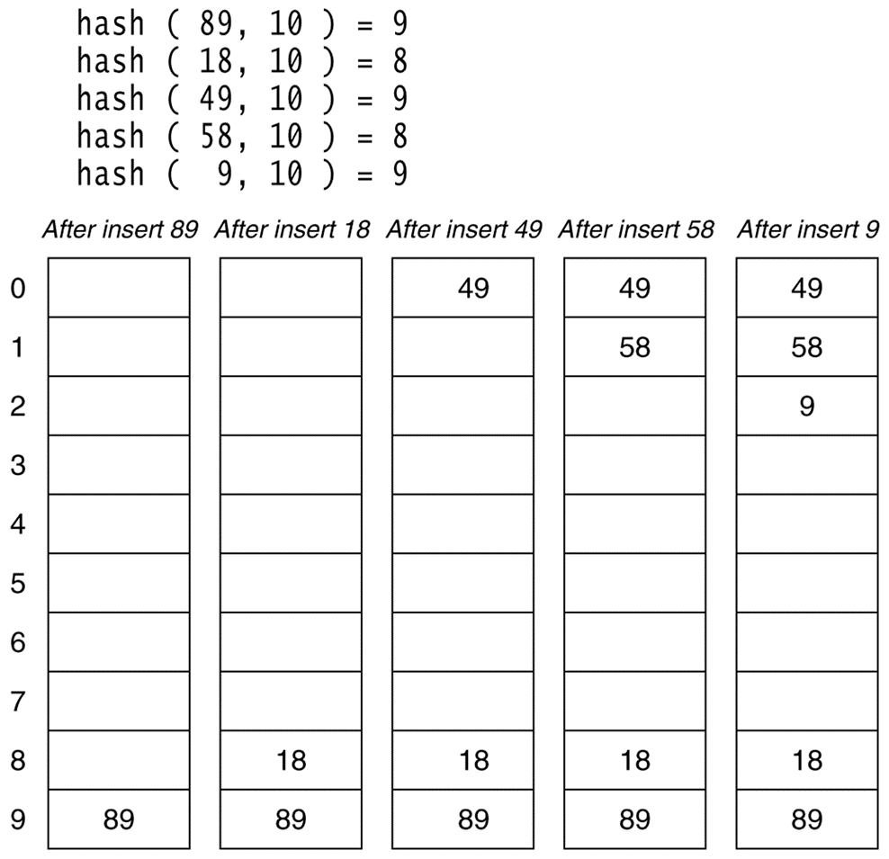
Exercise: Using linear probing, insert 89, 18, 49, 58 and 9 into a hash table of size 10.

Slide 14
Find
The find algorithm follows the same probe sequence as the insert algorithm.
A find for 58 would involve 4 probes.
A find for 19 would involve 5 probes.

Slide 15
Drawbacks of Linear Probing
Works until array is full, but as number of items N approaches TableSize (λ ≈ 1), access time approaches O(N)
Very prone to cluster formation (as in previous examples)
If a key hashes anywhere into a cluster, finding a free cell involves going through the entire cluster – and making it grow!
Primary clustering – clusters grow when keys hash to values close to each other
Can have cases where table is empty except for a few clusters
Does not satisfy good hash function criterion of distributing keys uniformly

Slide 16
(2.2) Quadratic Probing
Main Idea: Spread out the search for an empty slot – Increment by i² instead of i
H_{i}(x) = (hash(x) + i²) % TableSize
H₀(x) = (hash(x) + 0) % TableSize
H₁(x) = (hash(x) + 1) % TableSize
H₂(x) = (hash(x) + 4) % TableSize
H₃(x) = (hash(x) + 9) % TableSize

Slide 17
Quadratic Probing Example
insert(14)
14%7 = 0
insert(8)
8%7 = 1
insert(21)
21%7 =0
insert(2)
2%7 = 2
0
14
0
14
0
14
0
14
1
1
8
1
8
1
8
2
2
2
2
2
3
3
3
3
4
4
4
21
4
21
5
5
5
5
6
6
6
6
probes:
1
1
3
1

Slide 18
Problem With Quadratic Probing
insert(14)
14%7 = 0
insert(8)
8%7 = 1
insert(21)
21%7 =0
insert(2)
2%7 = 2
insert(7)
7%7 = 0
0
14
0
14
0
14
0
14
0
14
1
1
8
1
8
1
8
1
8
2
2
2
2
2
2
2
3
3
3
3
3
4
4
4
21
4
21
4
21
5
5
5
5
5
6
6
6
6
6
probes:
1
1
3
1
??

Slide 19
Problem with Quadratic Probing
Clustering may still happen with quadratic probing, and form so called secondary clusters, which are less harmful than primary clusters of linear probing.
If TableSize is prime and Load Factor λ<= ½, quadratic probing will find an empty slot; for greater λ, might not.

Slide 20
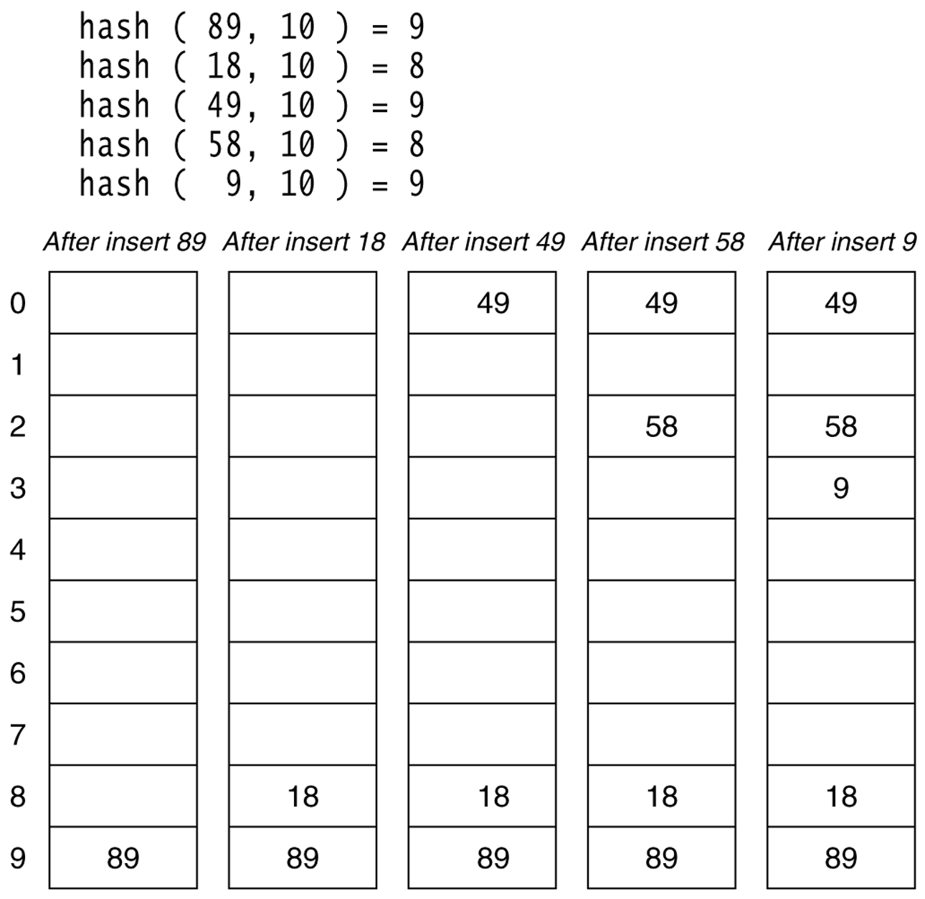
Exercise: Using quadratic probing, insert 89, 18, 49, 58 and 9 into a hash table of size 10.

Slide 21
(2.3) Double Hashing
Spread out the search for an empty slot by using a second hash function
No primary or secondary clustering
H_{i}(x) = (hash₁(x) + i*hash₂(x)) mod TableSize
for i = 0, 1, 2, …
Good choice of Hash₂(x) can guarantee does not get “stuck” as long as λ < 1.
The function hash₂(x) must never evaluate to zero.
A function such as hash₂(x) = R – (x mod R) where R is a prime smaller than TableSize will work well.

Slide 22
Double Hashing Example
insert(14)
14%7 = 0
insert(8)
8%7 = 1
insert(21)
21%7 =0
5-(21%5)=4
insert(2)
2%7 = 2
insert(21)
21%7 = 0
5-(21%5)=4
hash₂(x) = 5 – (x mod 5)
0
14
0
14
0
14
0
14
0
14
1
1
8
1
8
1
8
1
8
2
2
2
2
2
2
2
3
3
3
3
3
4
4
4
21
4
21
4
21
5
5
5
5
5
6
6
6
6
6
probes:
1
1
2
1
??

Slide 23
Double Hashing Example
insert(14)
14%7 = 0
insert(8)
8%7 = 1
insert(21)
21%7 =0
5-(21%5)=4
insert(2)
2%7 = 2
insert(21)
21%7 = 0
5-(21%5)=4
0
14
0
14
0
14
0
14
0
14
1
1
8
1
8
1
8
1
8
2
2
2
2
2
2
2
i=2
i=1
3
3
3
3
3
4
4
4
21
4
21
i=3
4
21
5
5
5
5
5
21
6
6
6
6
6
probes:
1
1
2
1
4

Slide 24
Exercise: Insert the following numbers (89,18,49,58,29) into an array of size 10 using the following hashing function: h_{i}(x) = (x mod 10 + i*(7 – x mod 7 )) mod TableSize
0
1
2
3
58
4
5
29
6
49
7
8
18
9
89

Slide 25
Comments on performance
When the table is full, clusters are more likely and search gets slow.
Load factor > 65%, linear probing becomes unacceptable
Load factor > 75%, quadratic probing becomes unacceptable
Load factor > 80%, double hashing becomes unacceptable
So: hash table cannot be too full.

Slide 26
Expected number of probes

Slide 27
Deletion in Closed Hashing
For chaining, it is simply removing an item.
Can cause problem in probing.
– The probing may stop.
– To avoid, don’t remove, but add a marker.
– Purge and remove after a while.
delete(2)
find(7)
0
0
0
0
1
1
1
1
Where is it?!
2
2
2
3
7
3
7
4
4
5
5
6
6

Slide 28
Lazy Deletion
Lazy deletion (i.e. marking items as deleted)
delete(2)
find(7)
0
0
0
0
Indicates deleted value:
if you find it, probe again
1
1
1
1
2
2
2
#
3
7
3
7
4
4
5
5
6
6

Slide 29
Acknowledgments
Data Structures and Algorithm Analysis in C++, Mark Allen Weiss, 4th ed, 2013. Chapter 5.
Data Structures Using C++, 2nd Edition, Malik, 2009, Chapter 9
Data Structures and Algorithms in C++ (2rd ed.), Michael T. Goodrich, Roberto Tamassia, David M. Mount, 2011. Chapter 9.
Data Structures and Algorithms in C++ (4rd ed.), Adam Drozdek,2005. Chapter 10.
Data Structures with C++ Using STL 2nd, Ford, 2001. Chapter 12.
Introduction to Algorithms, (3rd ed.), CLRS, 2009. Chapter 11
Henry Kautz notes

